Slide 1

CALVIN Winter 2024 Workshop
Mustafa Dogan
Center for Watershed Sciences
January 12, 2024
msdogan@ucdavis.edu
GitHub repo: https://github.com/msdogan/CALVIN-shortcourse

Slide 2
Hydroeconomic modeling
Combines water resources systems & economics
Allocates water among different users
Water allocations are driven by economic value of water
Economic costs & benefits are constrained by hydrology (water availability) & policies

Slide 3
Hydroeconomic modeling
Useful for
Represents regional scale hydrologic, engineering and economic aspects
Provide a framework for water resources systems
Solution-oriented tools for discovering new strategies
Investigates water management schemes and policy insights
Useful for water resources planning & management decisions

Slide 4
Components
Hydro-economic models represent all major hydrologic and engineering parts of the system
Water balance components
River flows, evaporation, groundwater recharge, and return flows
Infrastructure components
Canals, reservoirs, treatment plants, surface and ground water pumping, and artificial recharge
Water demands (agricultural, urban, and environmental), operating costs, and operating rules

Slide 5
Why an economical approach?
Water is a scarce source
Should be managed and allocated efficiently
Economics offers methods to evaluate equity and efficiency
Water has a value as a:
Commodity in various production processes
Diluter and transporter of waste
Recreational space
Ecological habitat

Slide 6
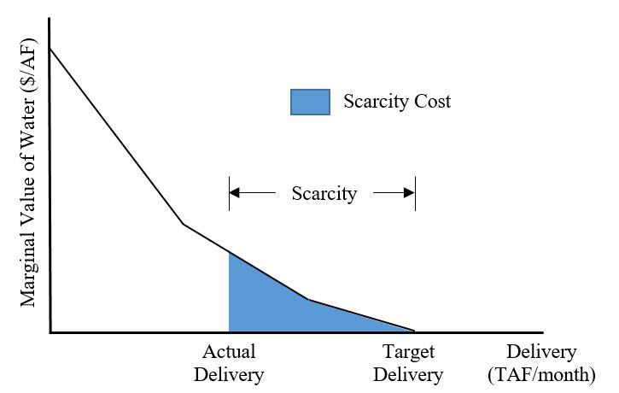
Economic Value of water
Demand Function
Unit Price of Water ($/AF)
Market Value

Slide 7
Formulation and design
Hydro-economic models use simulation and optimization separately or together.
Simulation (What if?)
Simulate decisions on a time-step
Based on operating rules
Optimization (What is best?)
Objective function (minimize costs, maximize benefits)
Physical and management constraints

Slide 8
Applications
Infrastructure planning and operation
Capacity expansion
Conjunctive use management (surface and ground water)
Water allocation and market
Adaptation (climate change)
Collaboration for conflict resolution
Design of institutional policies (water rights, flow requirements, no groundwater overdraft)

Slide 9
Limitations
Simplification and aggregation of physical, economic and regulatory processes and data
Deterministic approach (good future knowledge)
Linearization of non-linear functions
Ideal water market operations
Mathematical representation of social, environmental and political objectives

Slide 10
Overall
Hydro-economic models:
Represent engineered system, considering the economics of water demands and costs
Provide a framework for planning and operation
Increase system efficiency
Help decision-makers better operate complex water systems

Slide 11

CALVIN model
CALVIN = California Value Integrated Network
Hydroeconomic optimization model
Economics driven water allocation operations
Optimizes deliveries to users (minimizing total operating and scarcity costs)
Represents California’s water infrastructure
Historical monthly hydrology to represent hydrologic variability (Oct. 1921 to Sep. 2003)
2050 urban and agricultural demands

Slide 12
An integrated model
CALVIN is an integrated model
Surface water & groundwater resources are used conjunctively
Aggregated environmental, agricultural & urban demands are represented
The physical system is connected via rivers, canals, aqueducts, & reservoirs
Reservoirs carry water across time-steps (multi-period model)

Slide 13
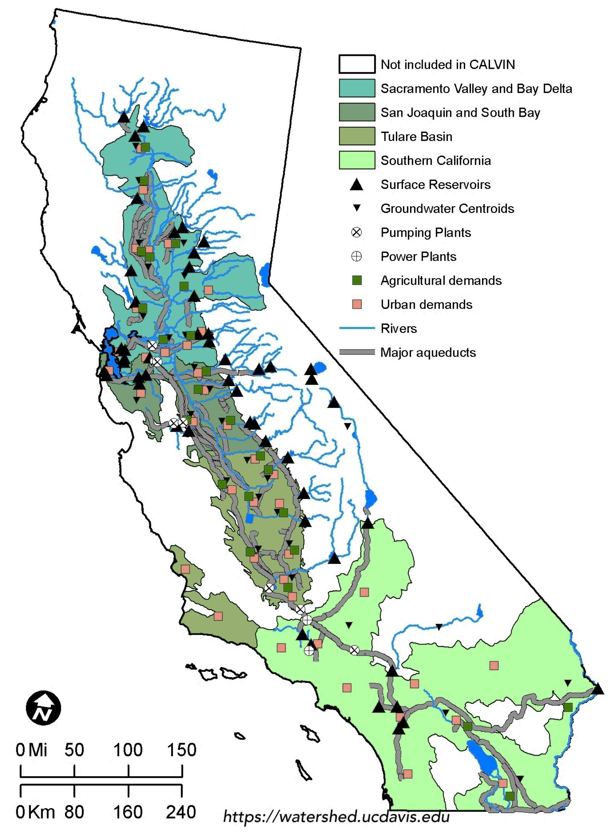
Model coverage
Most agricultural activities & urban population (~90%)
35 agricultural & 30 urban demand locations
9 wildlife refuge demands & 21 MIF requirements
33 groundwater basins, 53 surface reservoirs

Slide 14
Documentation
Appendix A | SWAP Model, Agricultural Water Values
Appendix B1 | Urban Water Values I
Appendix B2 | Urban Water Values II
Appendix C | HEC-PRM
Appendix F | Environmental Constraints
Appendix G | Operating Costs
Appendix H | Infrastructure
Appendix I | Surface Water Hydrology
Appendix J | Groundwater Hydrology
Appendix K | Irrigation Water Requirements
More information and documentation about CALVIN can be found at http://calvin.ucdavis.edu/
Also theses, dissertations and publications

Slide 15
Motivation for CALVIN
Interconnected water system
Integrated water management tools
Reservoir operations
Groundwater and conjunctive use
Water conservation
Wastewater reuse
Water markets and transfers
Can we make better sense of this integrated system?
How could system management be improved?
What is system’s reaction to changes in facilities and policies?

Slide 16
CALVIN studies
CALVIN has been used in numerous studies:
Climate change & adaptation
Groundwater overdraft
Effects of removing a dam
Marginal value of expanding storage
Marginal value of adding/expanding infrastructure

Slide 17

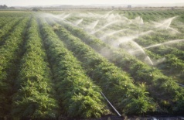

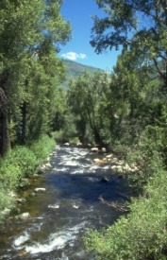
Model Components
Water sources
Rim inflows, groundwater inflows and local runoff
Demand locations
Agricultural, urban, and wildlife refuge
Conveyance infrastructure
Reservoirs, pumping facilities, and canals
Capacity constraints
Regulatory requirements
Minimum in-stream flow requirements
City A
River
Agriculture
City B
Aquifer

Slide 18
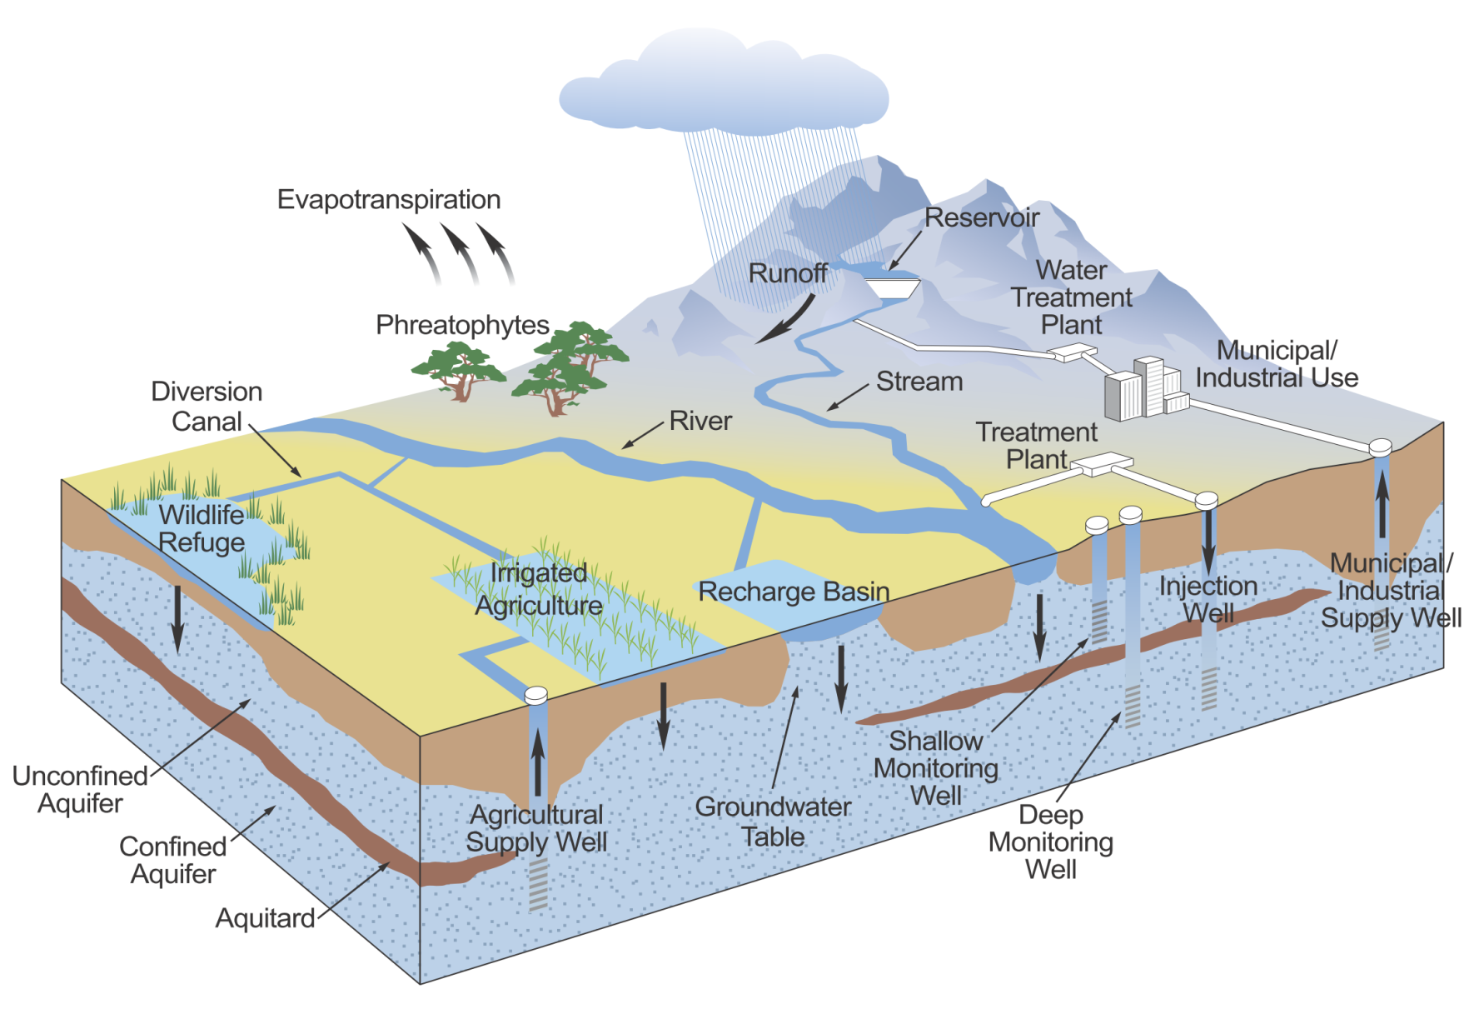
Hydrology
SEEPAGE/ EVAPORATION LOSSES
RIM INFLOWS (CalSim II)
NET RESERVOIR EVAPORATION (CalSim II)
LOCAL ACCRETIONS/ DEPLETIONS (CalSim II)
GW INFLOWS (C2VSim)

Slide 19
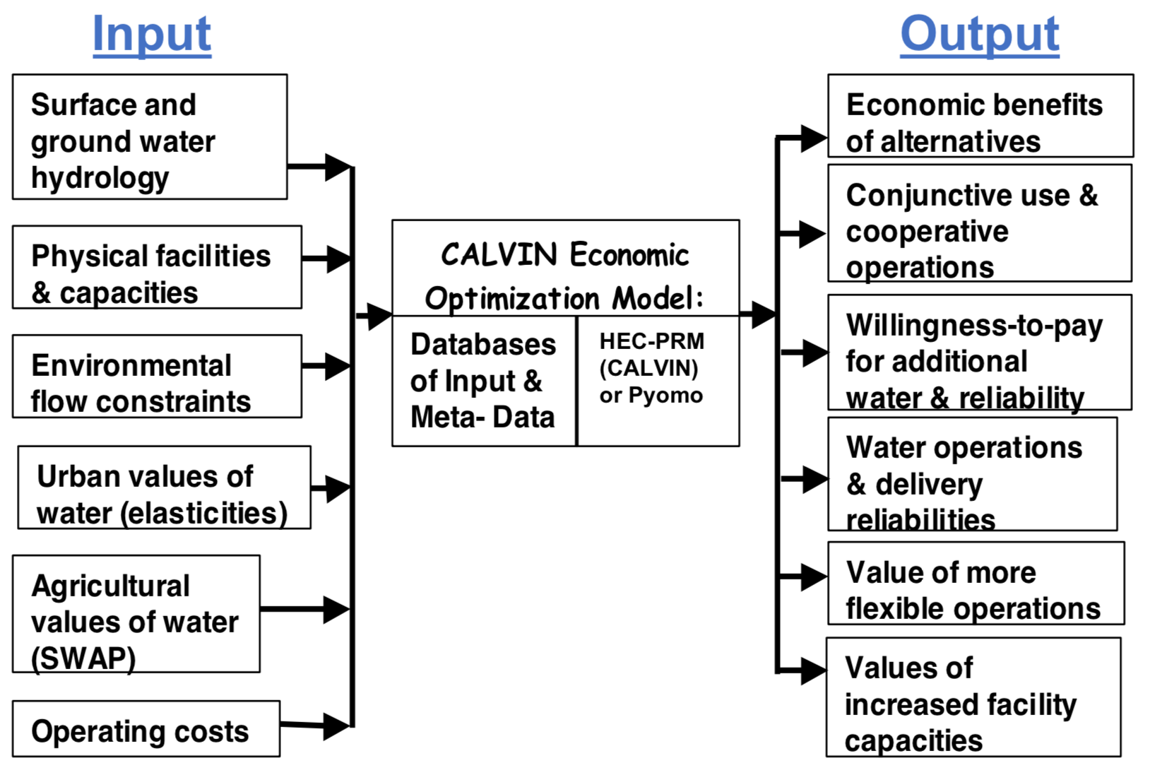
Data overflow
Water operations are driven by economic value of water: Hydrologic data + economic data

Slide 20
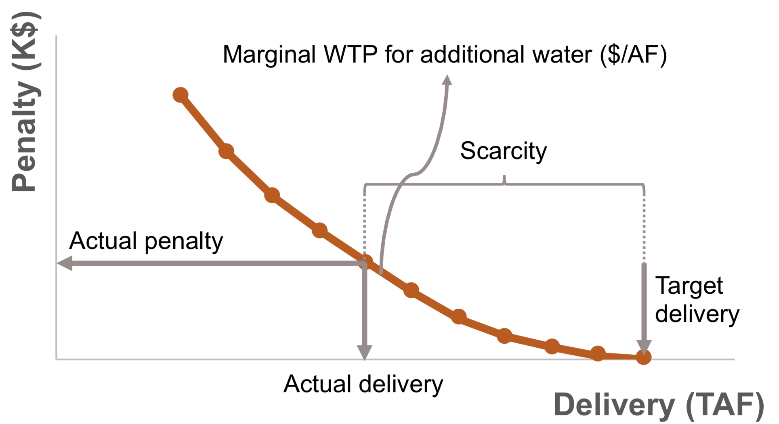
Economic value of water
Monthly varying total cost curves derive operations for agricultural & urban deliveries & hydropower
Whenever a user’s total demand (target delivery) is not met, scarcity occurs
The difference between target & actual deliveries = scarcity
The scarcity cost (penalty) is total loss due to lack of water related activities

Slide 21
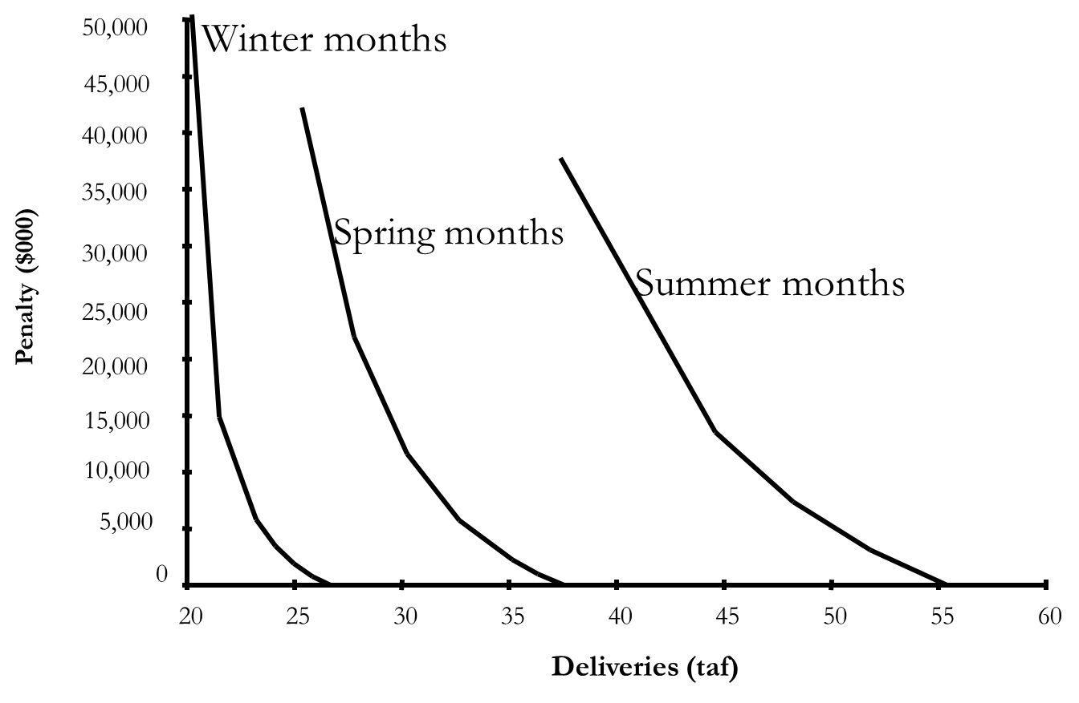
Demand curves
Agricultural demand in different seasons
Less flexibility (steeper slopes)
More flexibility (smaller slopes)

Slide 22
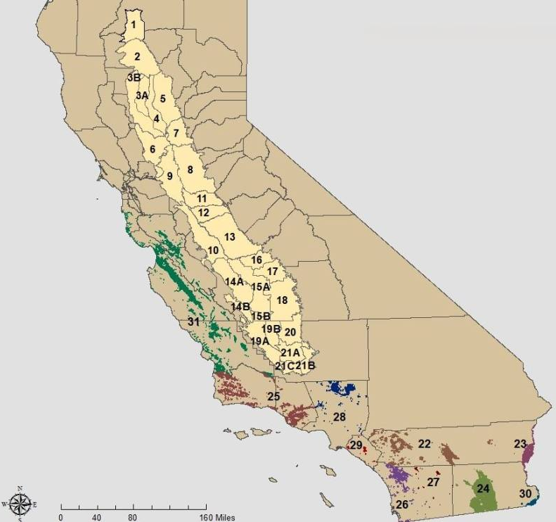
Agricultural demand
CVPM 1-21 in the Central Valley
Southern California demand locations
SWAP model is used to create penalty curves

Slide 23
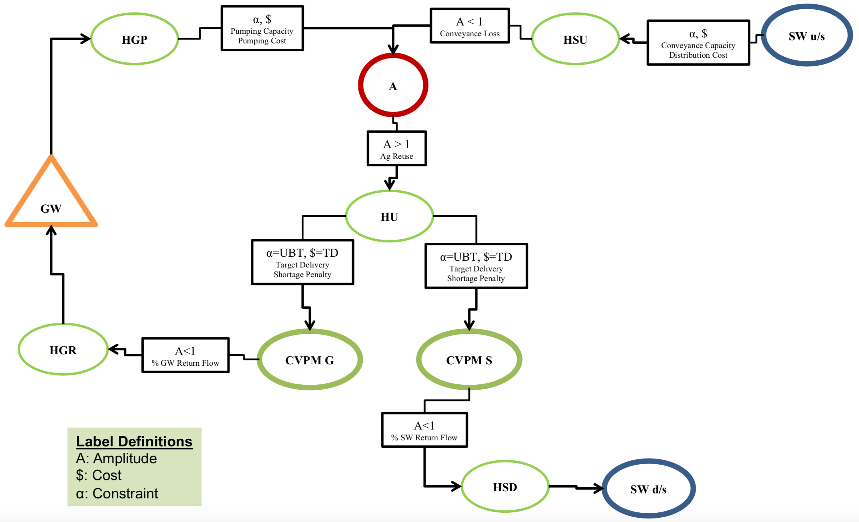
Agricultural demand
Two supply sources: groundwater & surface
Aggregated demand is divided into two parts based on return flow to groundwater or surface water

Slide 24
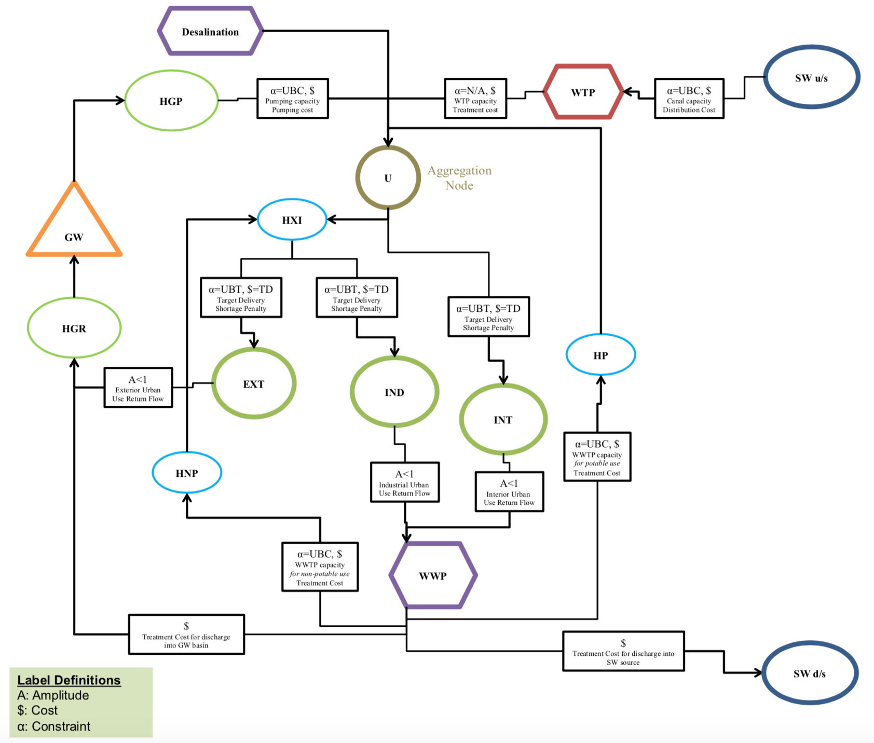
Urban demand
Interior & exterior residential, & industrial demands
Water sources:
Surface water
Groundwater
Desalination
Potable & non-potable recycled water

Slide 25
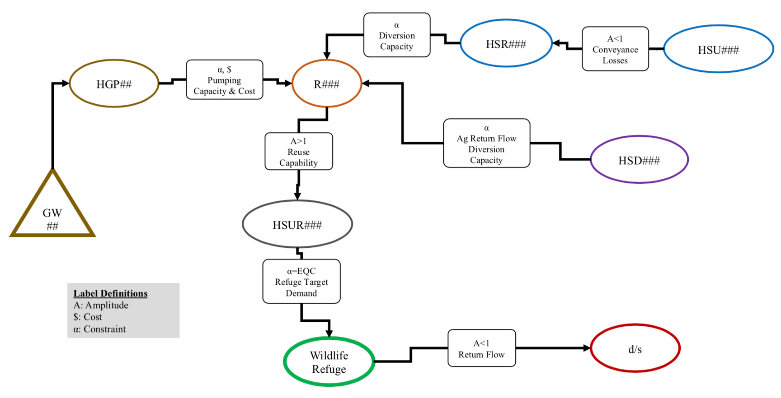
Wildlife refuge demand
9 wildlife refuge demand locations
No economic representation
Constrained water deliveries
Supply sources:
Surface water
Groundwater
Agricultural return flow

Slide 26
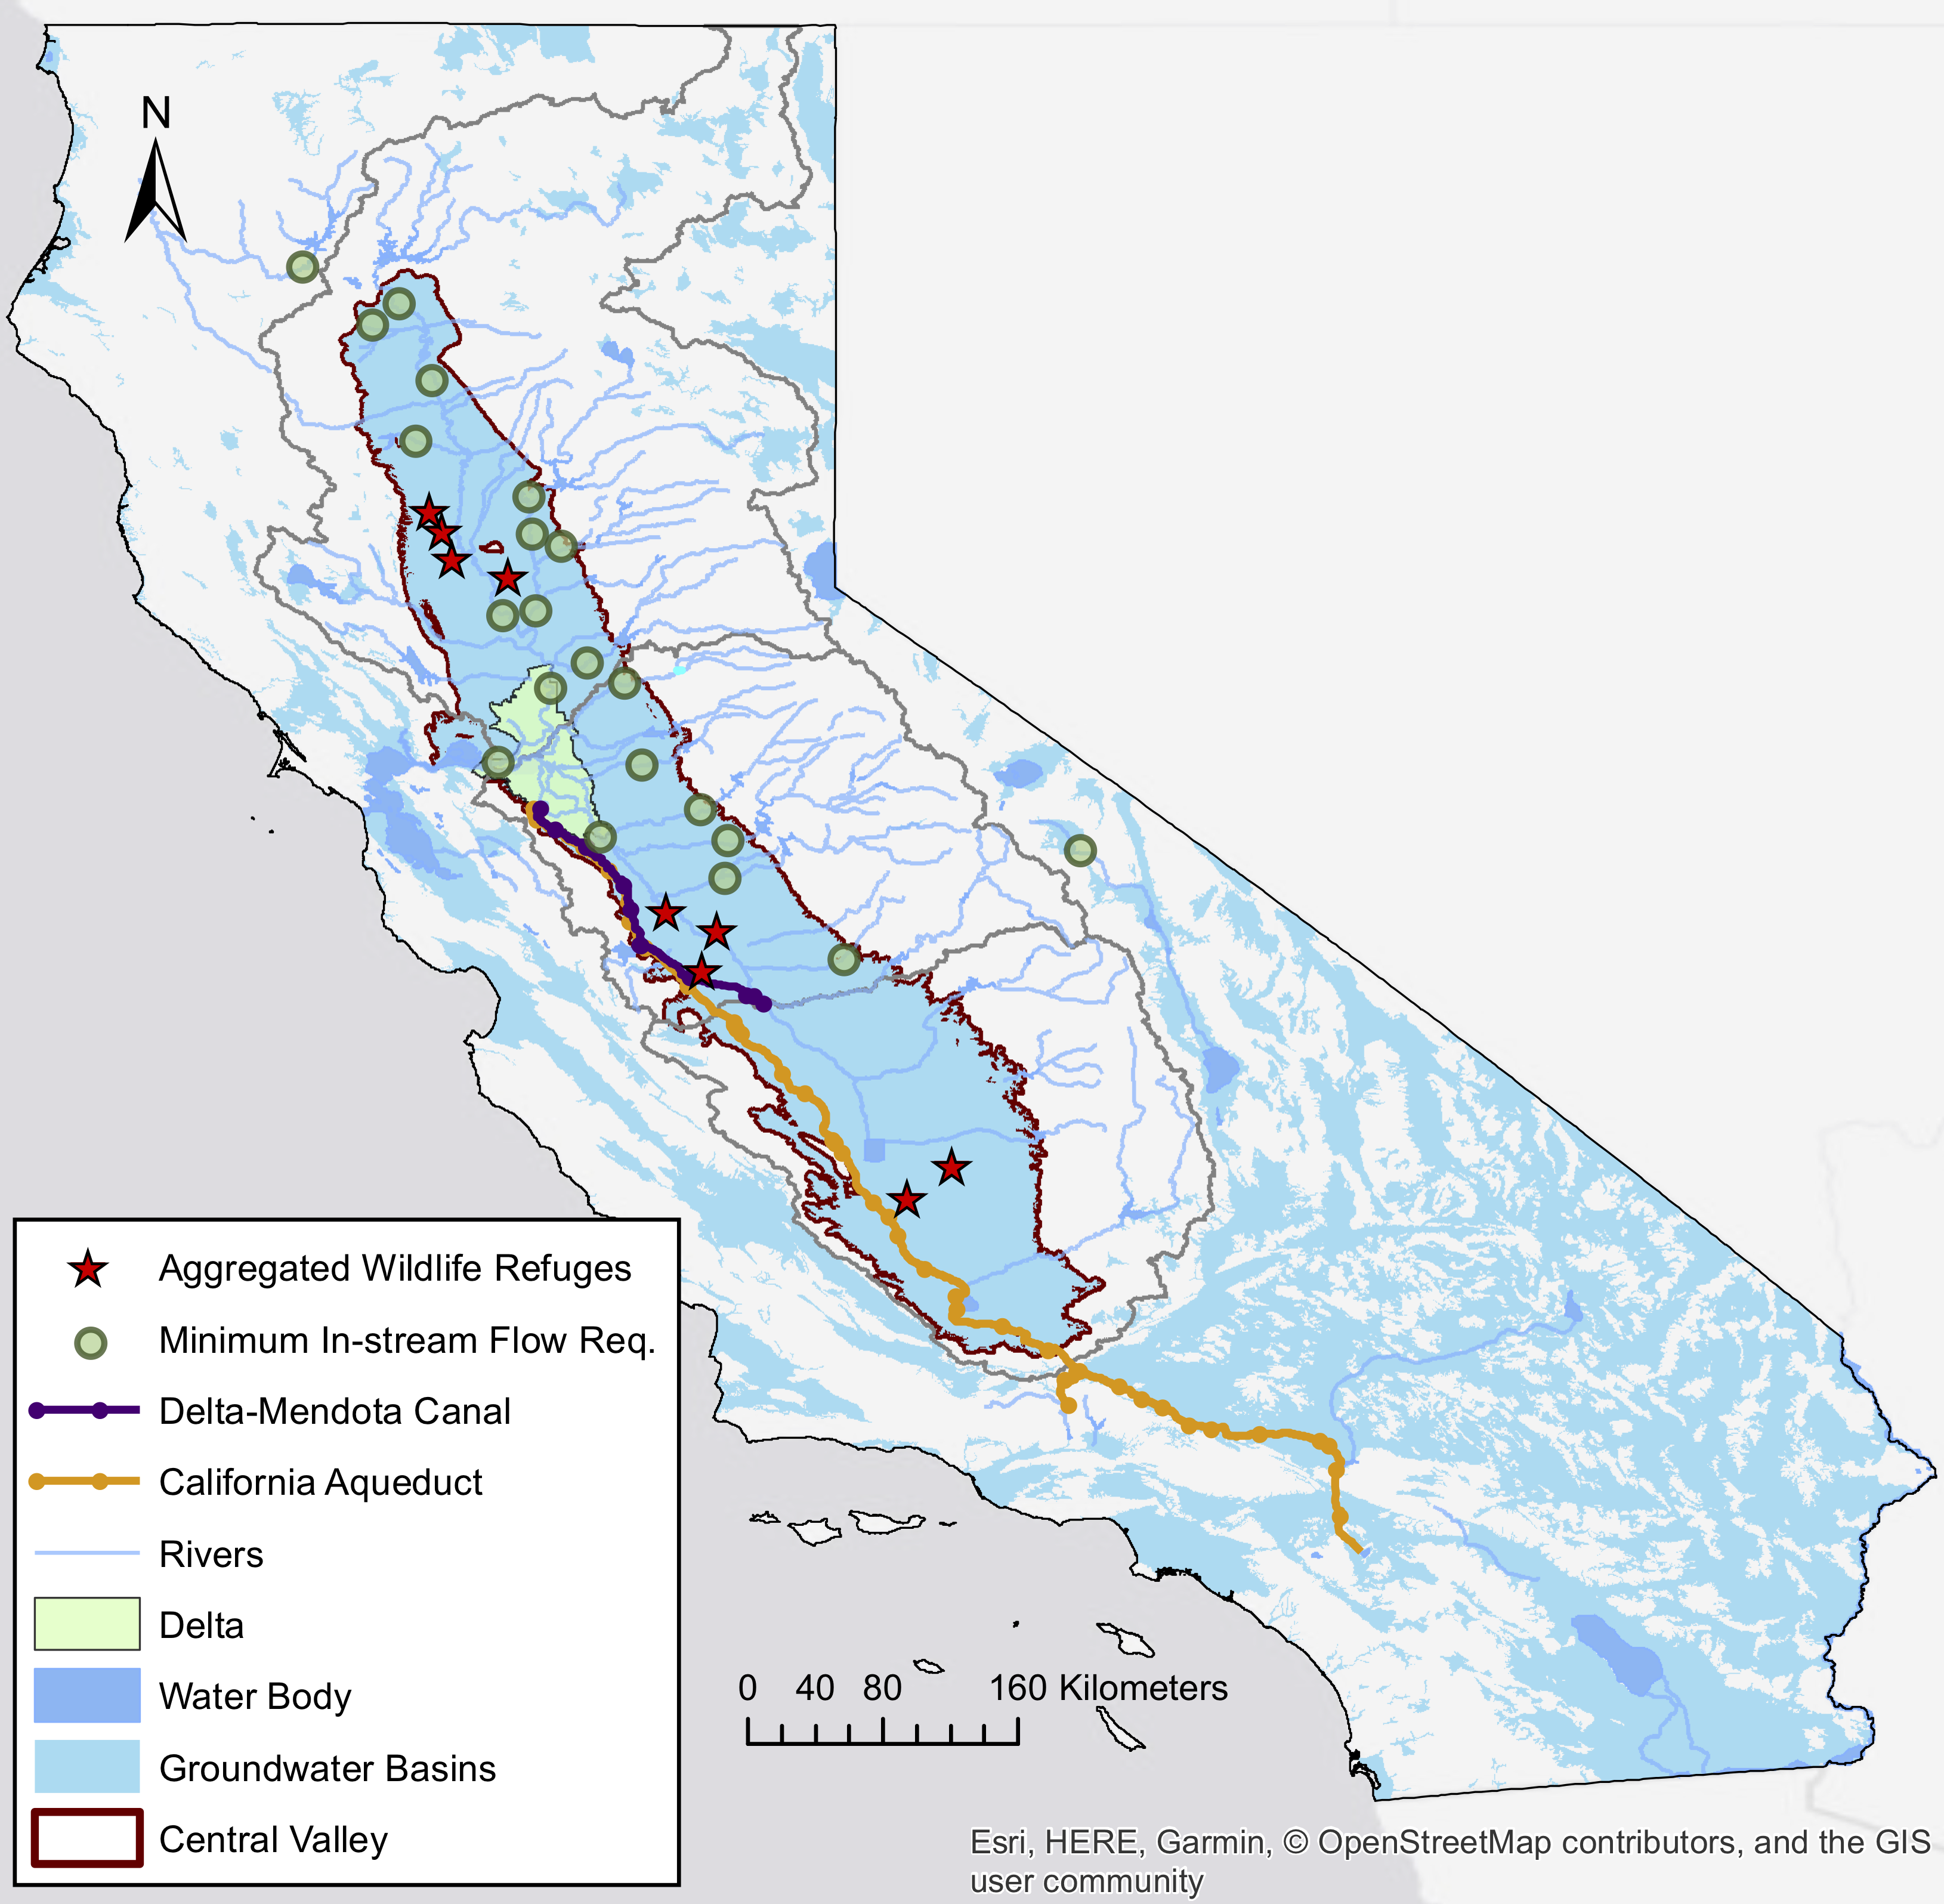
MIF Requirements
Minimum in-stream flow requirements due to aquatic habitat needs
Represented as lower bound constraints
Mostly time-series obtained from CALSIM II model

Slide 27
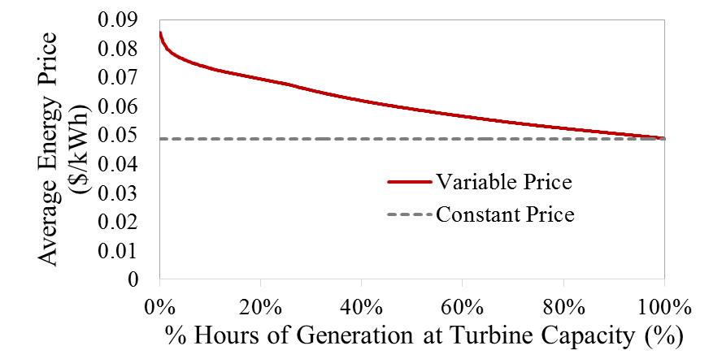
Hydropower
Monthly hydropower operations
Penalty for not generating hydropower (reverse of a benefit curve)
Represented on reservoir storage and release
Hourly average energy prices

Slide 28
CALVIN limitations
CALVIN has several limitations:
Perfect hydrologic knowledge (limited in limited foresight model)
Simplified groundwater representation (unit fixed pumping cost)
Linearized cost curves (piecewise linear)
Simplified hydropower representation due to linear programming (LP) framework

Slide 29
Lessons from CALVIN
CALVIN results show that
Regional or statewide markets can reduce water scarcity costs
Environmental flows have economic values for agricultural and urban and hydropower activities
Economic values exist for expanded facilities
Some scarcity is optimal
Integrated local, regional, and statewide operation of water decreases competition with environmental uses (water trading)

Slide 30
CALVIN goals
The recent updates aims to
Create a cross-platform model: MacOS, Windows
Use open data format: csv, JSON
Have freely available: data, code, modeling language & solvers are open-source or free of charge
Separate model & data:
HOBBES is independent from any data
CALVIN’s structure code is generalized (can solve any other network-flow problems)

Slide 31
CALVIN improvements
The original CALVIN uses HEC-PRM to solve its optimization problem
With recent updates, CALVIN is moved to Python
Pyomo library, a high level optimization modeling language in Python, is used
Pyomo can connect to several freely available solvers
Runtime is decreased from 2-5 days to 30min-1 hr, with parallelization in Pyomo.

Slide 32
HOBBES database
https://cwn.cws.ucdavis.edu
A web-based open-source data storing and sharing platform
Stores California’s water network data
Documentation and change tracking via GitHub
Data visualization and animation
Several models can be built around HOBBES, where built-in tools convert and export network data in the desired format
HOBBES
Database
CALVIN
HEC-PRM
CALVIN
Python version
Water-Energy
network-flow
Other models
...

Slide 33
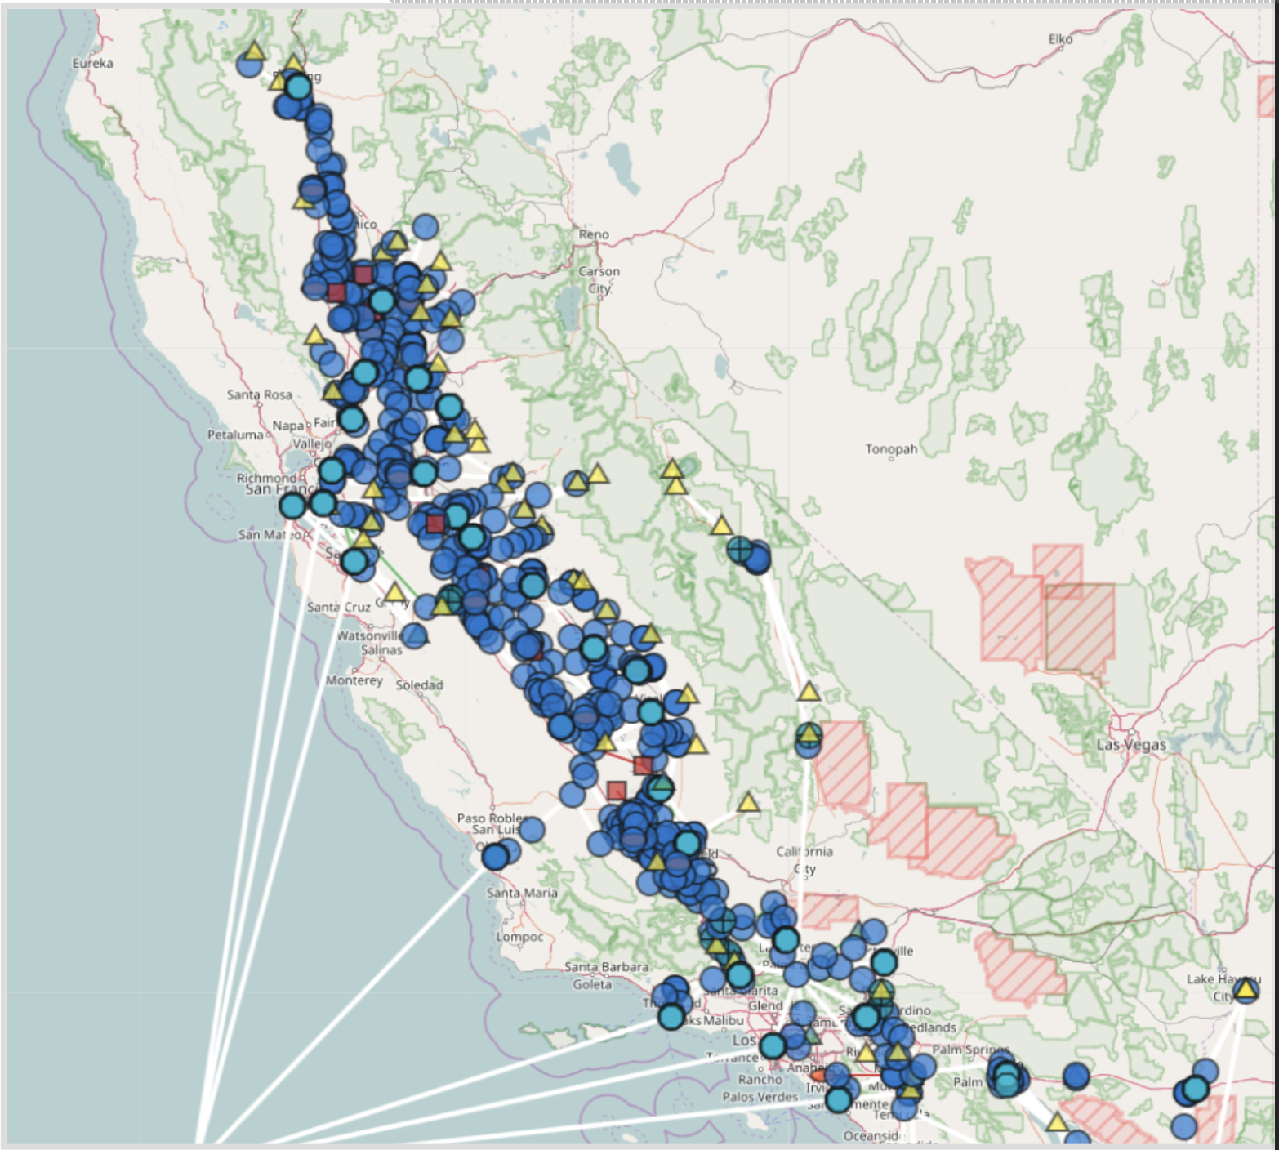
HOBBES visualization
California water network
Geocoded network elements
Layered based on hydrologic regions and subregions
Data visualization
Animation tool

Slide 34
HOBBES for CALVIN (Python)
CALVIN Python version uses matrices for all parameters: c, a, l, u
Calvin-network-tool in HOBBES converts input data into a network matrix
The network matrix is input to CALVIN (Python)
Each of network matrix lines correspond to a link – decision var. (full size model has 6 millions)
i | j | k | c | a | l | u

Slide 35
Network-flow model
CALVIN represents the physical system with nodes and links
Nodes represent reservoirs, demand locations, power and pumping plants and junctions
Links only connect nodes to each other
All network parameters are applied to links: amplitude (loss factor) a, unit cost c, lower bound l, & upper bound u

Slide 36
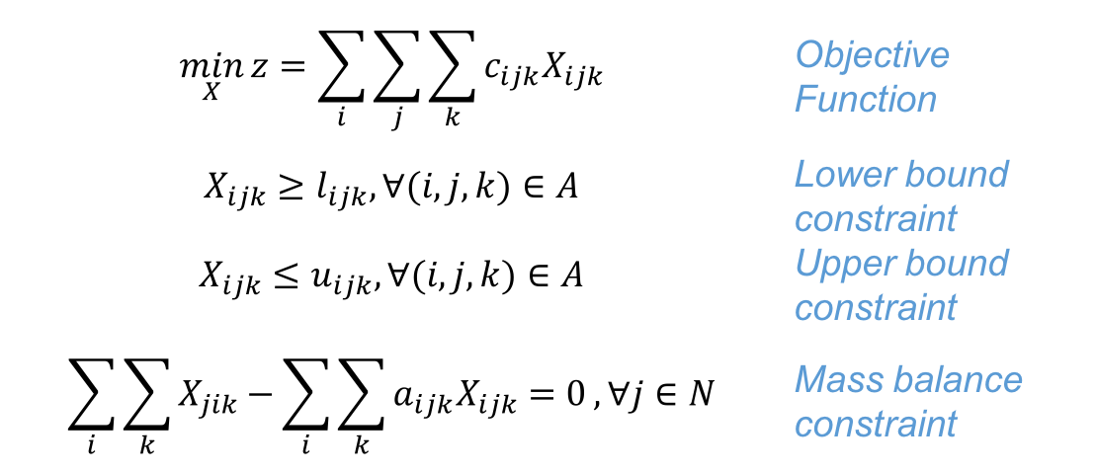
Linear Programming model
As an network-flow LP model, CALVIN minimizes statewide water scarcity and operating costs within constraints
$$\min_{X}{z=\sum_{i}{\sum_{j}{\sum_{k}{c_{ijk}X_{ijk}}}}}$$ | Objective Function
$$X_{ijk}≥l_{ijk}, ∀(i,j,k)∈A$$ | Lower bound constraint
$$X_{ijk}≤u_{ijk}, ∀(i,j,k)∈A$$ | Upper bound constraint
$$\sum_{i}{\sum_{k}{X_{jik}−\sum_{i}{\sum_{k}{a_{ijk}X_{ijk}=0}}}}, ∀j∈N$$ | Mass balance constraint
where X is flow (decision variable); c is unit cost; l is lower bound; u is upper bound; a is amplitude
index i represents origin node; j is terminal node; k is a piecewise component

Slide 37
Resolving infeasibilities
When a mass-balance constraint at any location is not met, the model results in infeasible solution
Due to size of the model, in case of infeasibility, you never know where the problem is
Flow =
100 TAF
Flow =
100 TAF
Capacity =
550 TAF
Lower Bound =
650 TAF
Flow =
500 TAF
Flow =
500 TAF

Slide 38
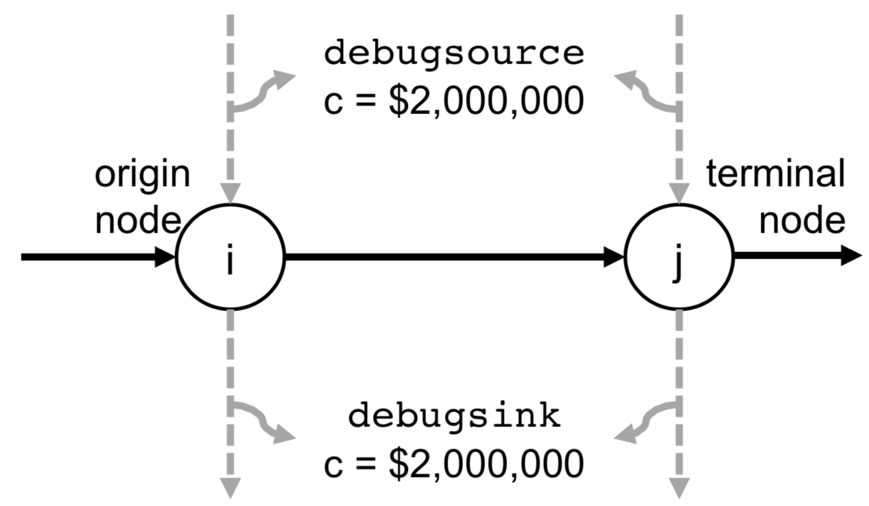
Debug mode
When network is modified (climate change, adding a new requirement or element etc.), first run in debug mode
Debug mode adds two links (debug source & debug sink) at very high cost (~10¹⁰)
The debug cost is much higher than any other cost in CALVIN to make sure it is not used unless there is infeasibility
Then postprocess to
eliminate debug flow
c = $10¹⁰
c = $10¹⁰

Slide 39
CALVIN runtime
Solver wall clock runtime for different model sizes
Installed solvers:
GLPK
CBC
Gurobi
CPLEX
Log-log scale: exponential increase of runtime

Slide 40
A small network example
Modeling of a reservoir with following properties
Two time-steps

Slide 41
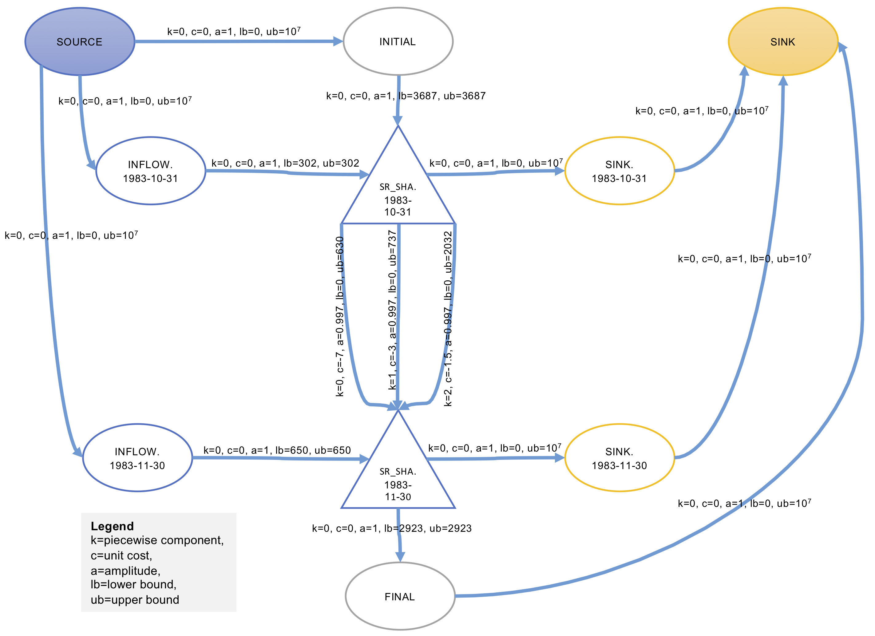
Network-flow form

